Slide 1
Use Case 1: Synchronized Time Across Devices - STAD Technical View
NTP Service
SDC LAN
Monitor
Pump
Ventilator
Monitor
Pump
Ventilator
Patient
Patient

Slide 2
Use Case 2: Standalone ICU Dashboard sp – SICDsp Technical View
ICU Bed Dashboard
SDC LAN
Monitor
Pump
Ventilator
Patient

Slide 3
Use Case 3: Standalone ICU Dashboard mp – SICD Technical View
ICU Dashboard
SDC LAN
Monitor
Pump
Ventilator
Monitor
Pump
Ventilator
Patient
Patient

Slide 4
Use Case 4: Device Data to Enterprise Systems - DDES Technical View
Data GW Service
Enterprise System
SDC LAN
Monitor
Pump
Ventilator
Monitor
Pump
Ventilator
Patient
Patient

Slide 5
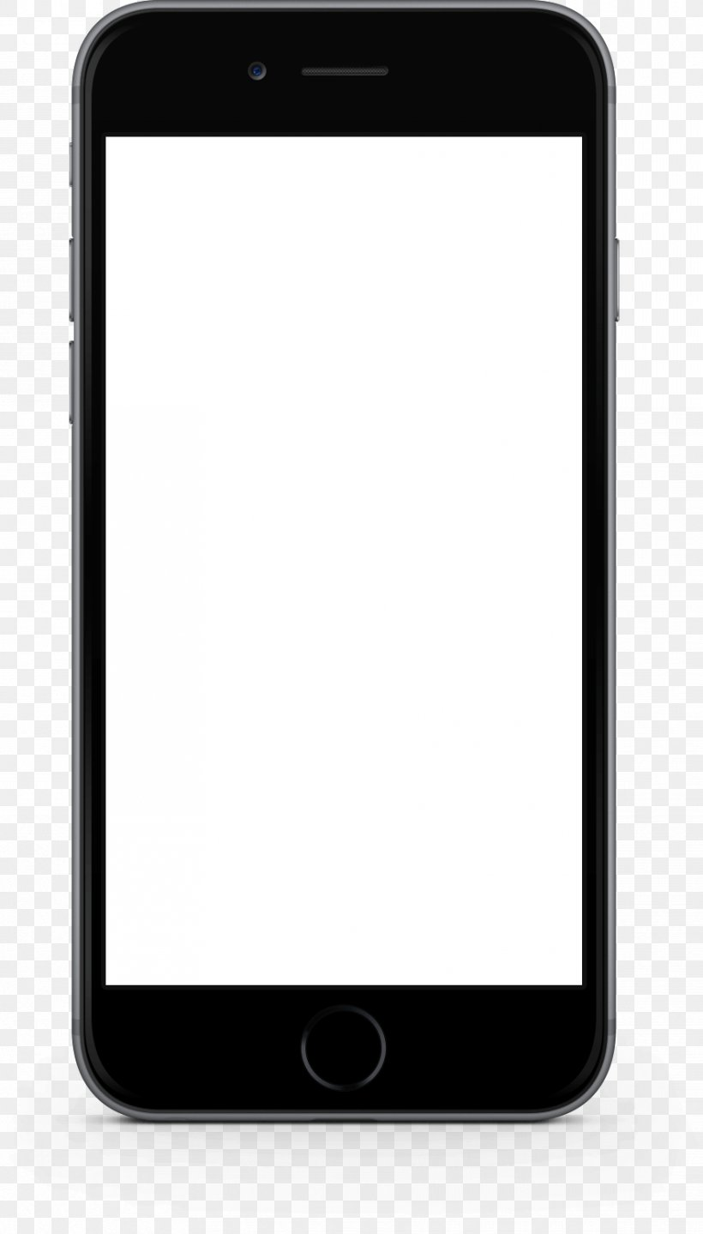
Use Case 5: Alerts to Clinician Notification Systems - ACNS Technical View
Alert GW Service
Clinician Notific. System
SDC LAN
Monitor
Pump
Ventilator
Monitor
Pump
Ventilator
Patient
Patient

Slide 6
Use Case 6: Alerts to Alert Recording Systems - AARS Technical View
Alert GW Service
Alert Recording System
SDC LAN
Monitor
Pump
Ventilator
Monitor
Pump
Ventilator
Patient
Patient

